Slide 1


Detecting Tremor in Parkinson’s Disease using Multiple Instance Learning on Kinetic Data Collected from Wearable Device
Jiayi Han s164229
10/2/2022
Technical University of Denmark
Supervisors
Sadasivan Puthusserypady
Silvia Tolu
Paragit Solutions

Slide 2
Presentation outline
Introduction
Background
Data
Methodology
Results
Discussion
Future perspectives
Conclusion
Limitations

Slide 3
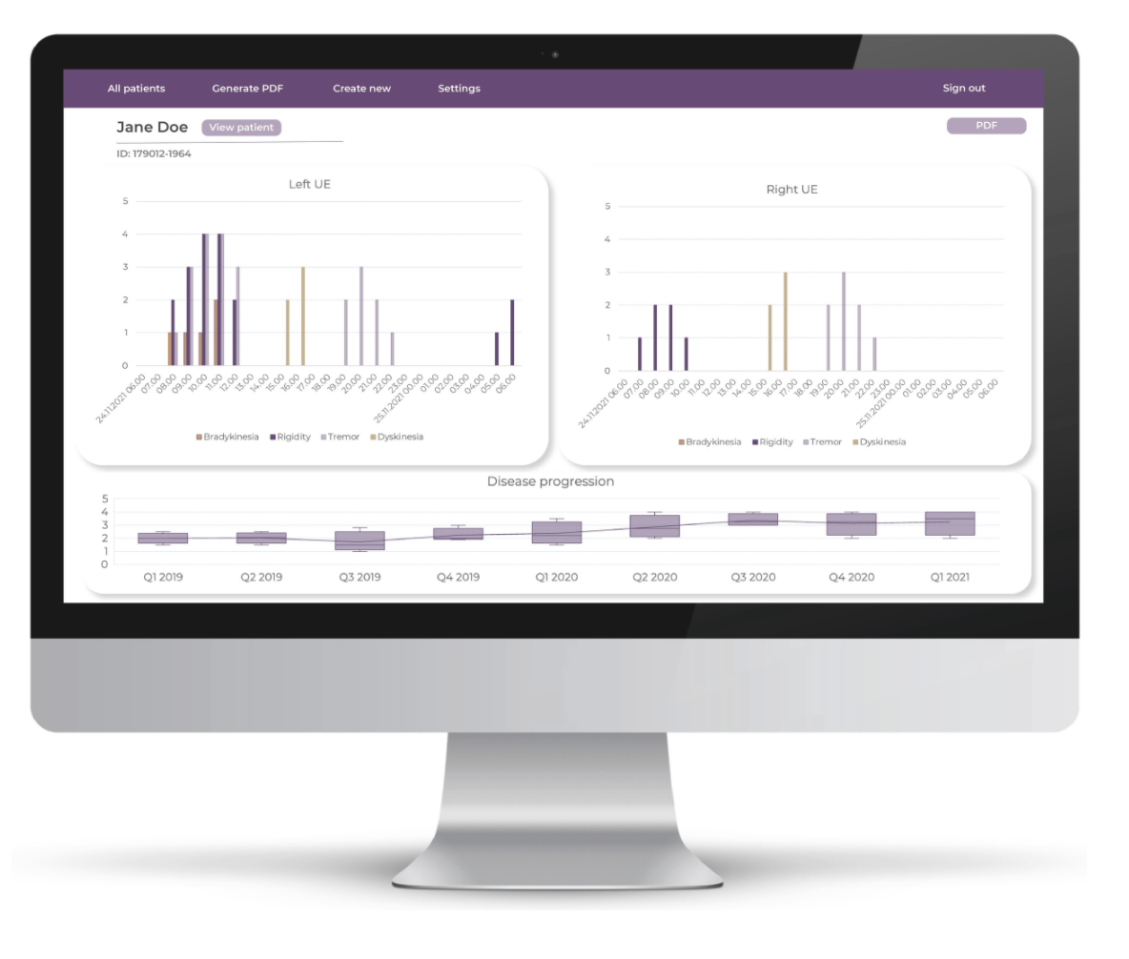
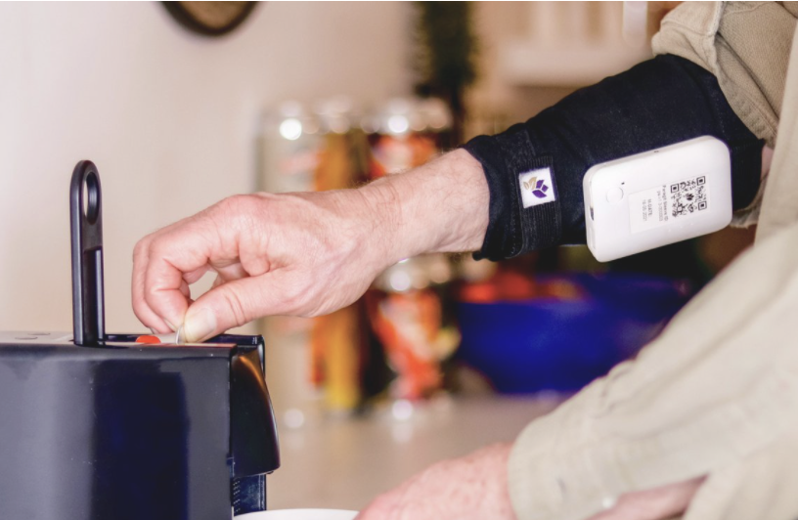
Introduction – Paragit Solutions
Startup company working with Parkinson’s Disease monitoring
The sleeve measures gyroscope, accelerometer and sEMG
The current algorithm for symptom detection is based on static thresholds

Slide 4

Introduction – Project Motivation
The Motivation
Current diagnosis is subjective and inaccurate
Wearable devices collect objective data
Ease the burden of the PD-subjects and increase the diagnostic accuracy
Data based method, Continuous monitoring
The aim: Build and test tremor detection algorithm
The challenges
The wild data
The labelling

Slide 5

Intro - Parkinson’s Disease
Progressive neurological disorder
MDS-UPDRS rating scale is the current golden standard
The current way of diagnosis is subjective and has inter-rater and intra-rater variability
This project focuses on the tremor from the upper extremity
Involuntary and rhythmic contraction
Frequency between 3-7 Hz

Slide 6
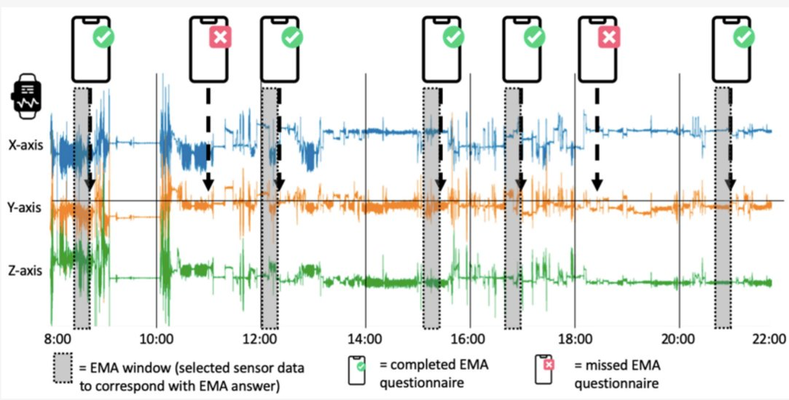
Data – Overview
Originally the plan is to use Paragit Solutions’ data
Delays & labels
Online data sources
Habets et al.
Accelerometer, gyroscope and wildness
14 days
20 participants
Smartwatch
Smartphone

Slide 7

Data– Questionaires

Slide 8
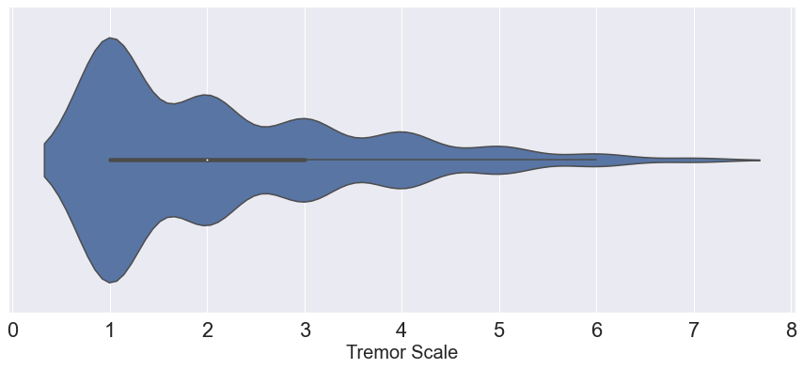
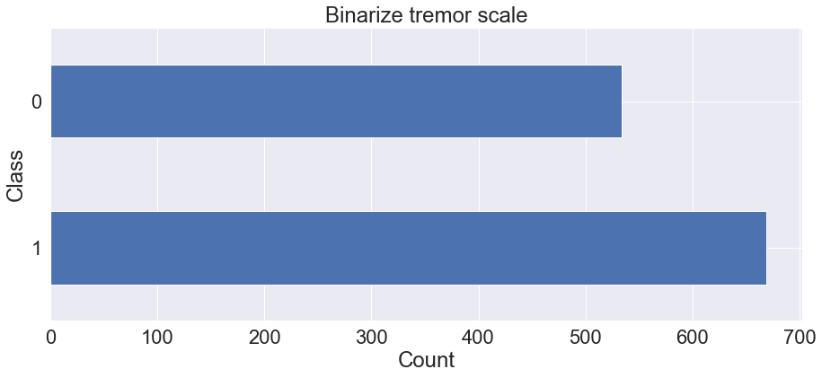
Data - Content

Slide 9
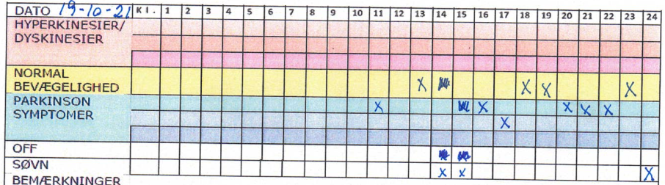
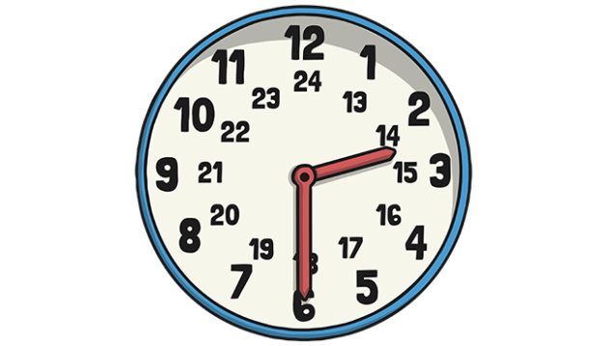
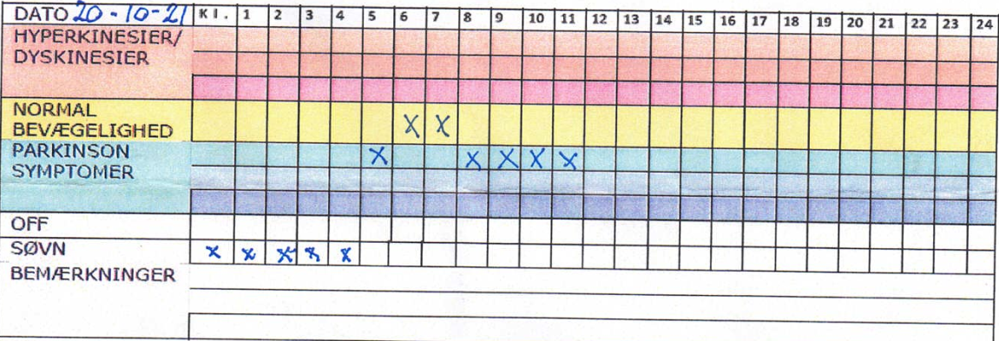
Data - Paragit Solutions
Approximately 24 Hours of recording
For testing the model

Slide 10
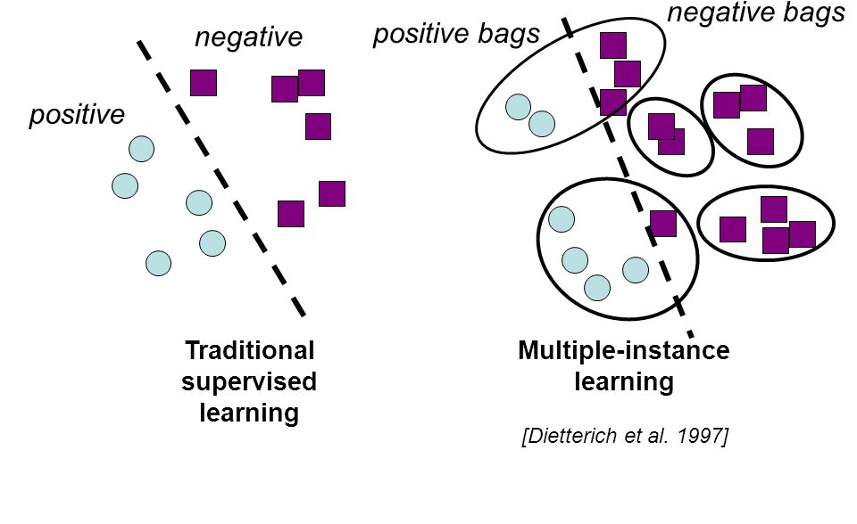
Methodology - Multiple Instance learning
General description
Our case
Positive bag
Negative bag
Multiple instance learning
A bag is considered positive if there’s one or more positive instances

Slide 11
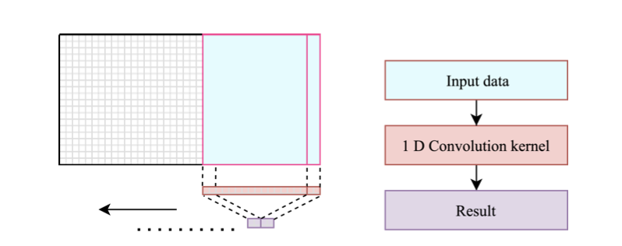
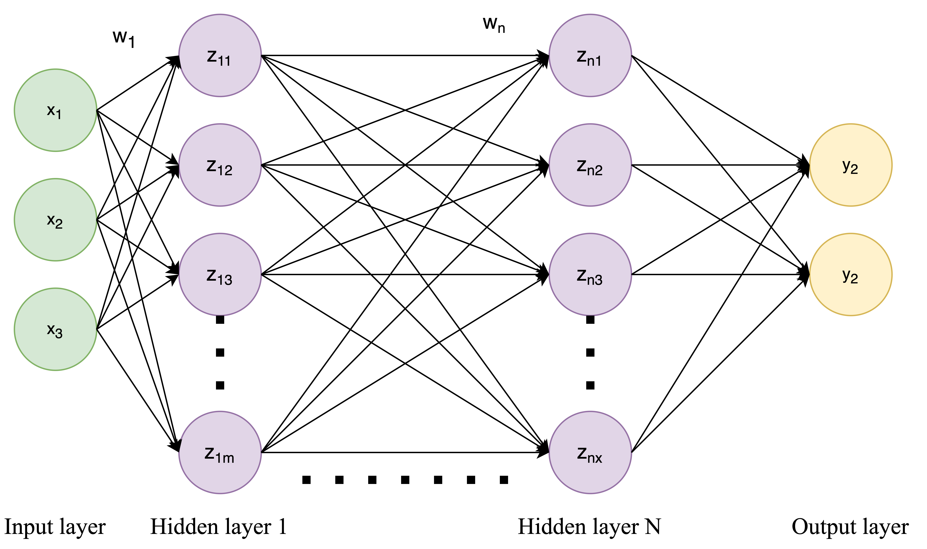
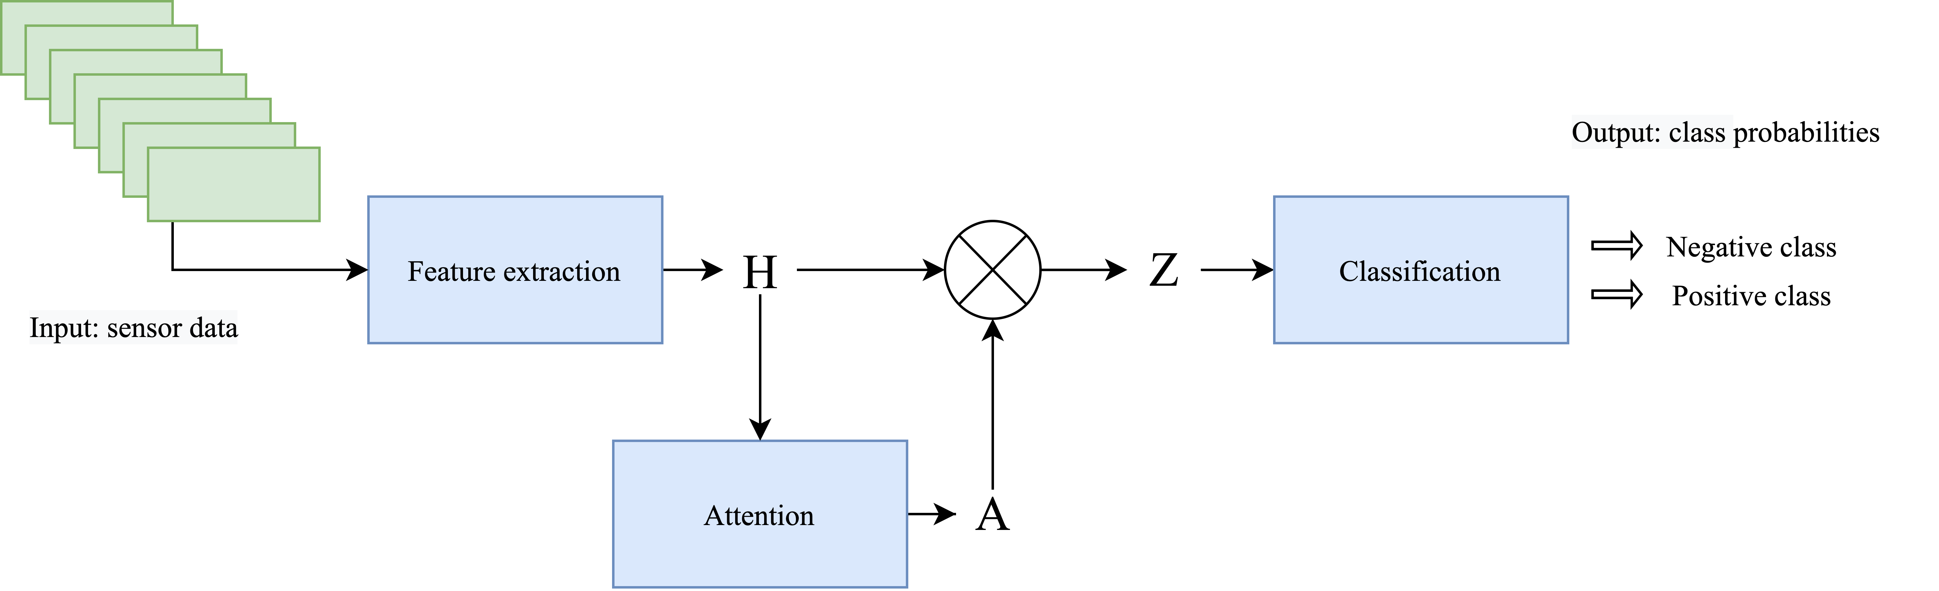
Methodology – Attention Based Multiple Instance Learning
Proposed by Ilse et al. Attention-based Deep Multiple Instance Learning (2018)
Implemented for tremor detection by Papadopoulous et al. (2020)

Slide 12
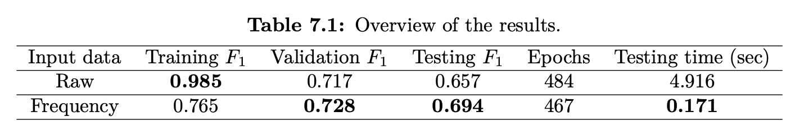
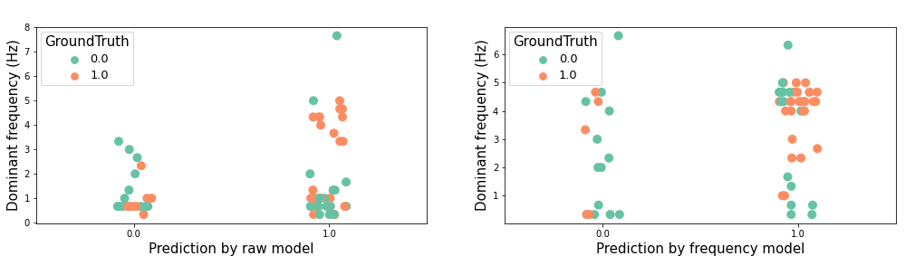
Results - General

Slide 13
Results - Related study
The most suitable method were the Multiple Instance Learning method proposed by Papadopoulous et al.
Signal processing experts: 2 experts annotating raw accelerometer signals
UPDRS 16: Subject’s self report about tremor
UPDRS 20: Physician’s score for hand tremor at rest
 | Signal processing experts | UPDRS16 | UPDRS20
F1-score | 0.897 +/- 0.015 | 0.615 +/- 0.011 | 0.706 +/- 0.003
[2] Detecting Parkinsonian Tremor from IMU Data Collected In-The-Wild using Deep Multiple-Instance Learning (2020)​

Slide 14
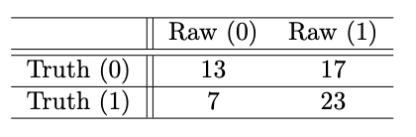
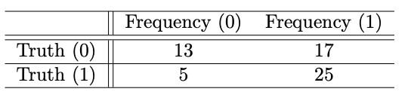
Results- Confusion matrix

Slide 15
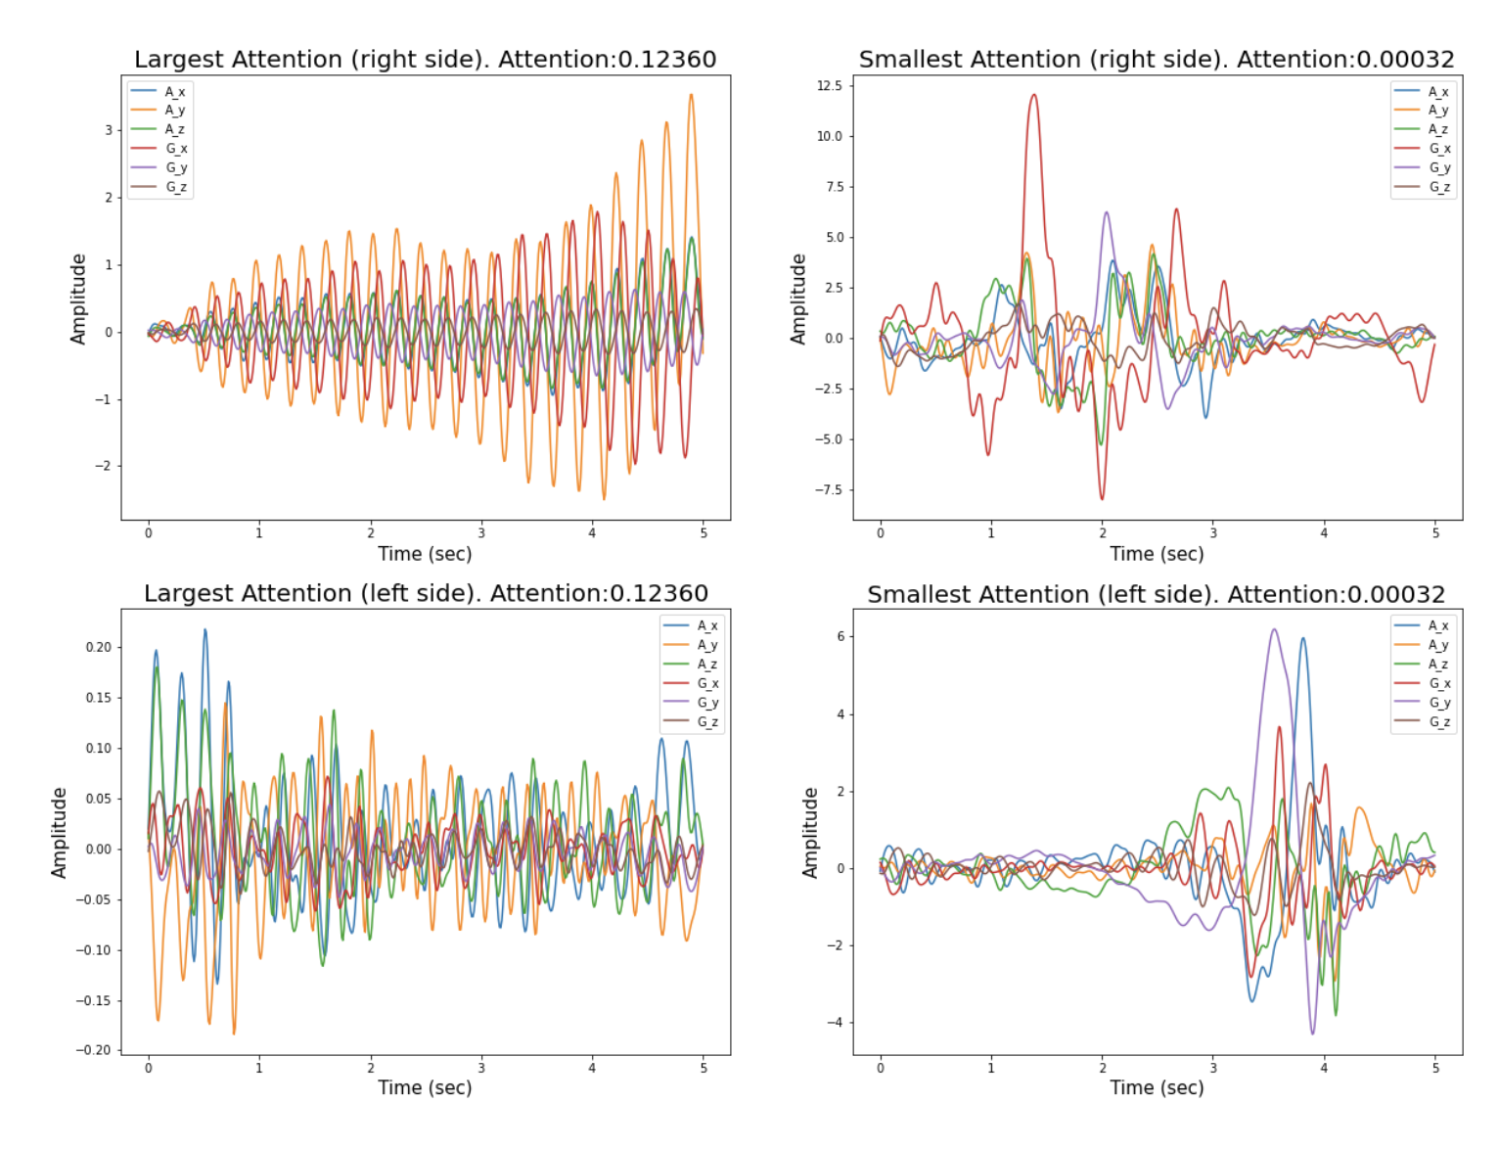
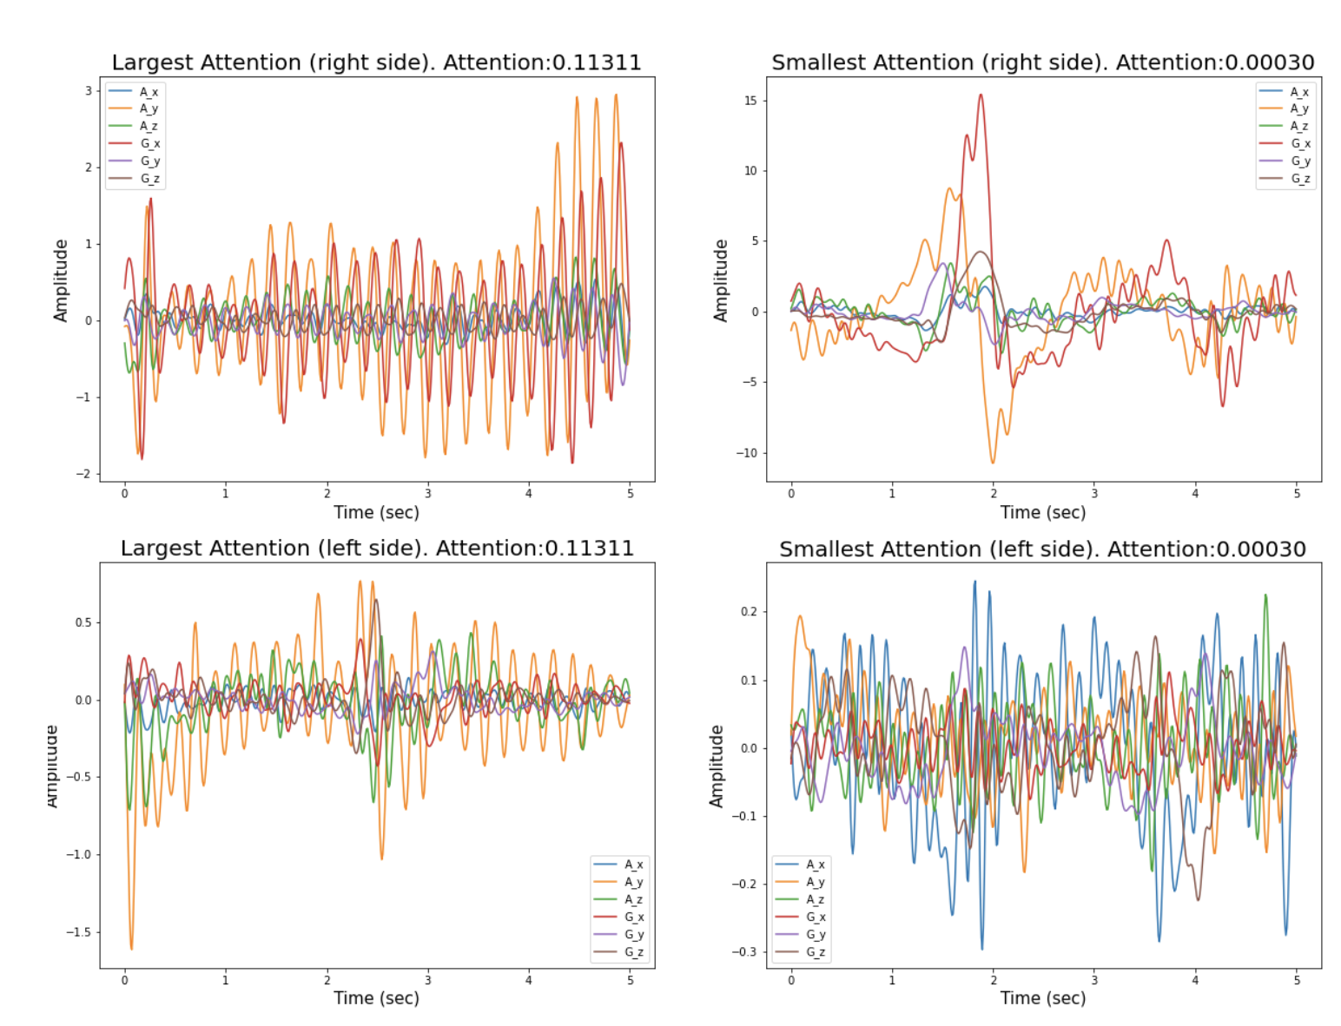
Results - Raw-model
True positive
False positive

Slide 16
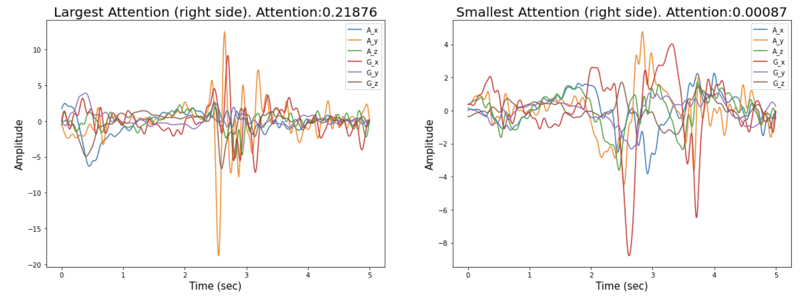
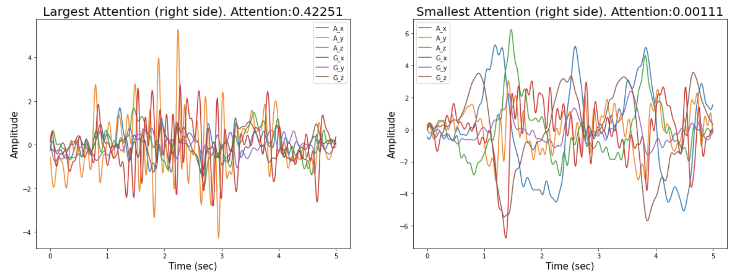
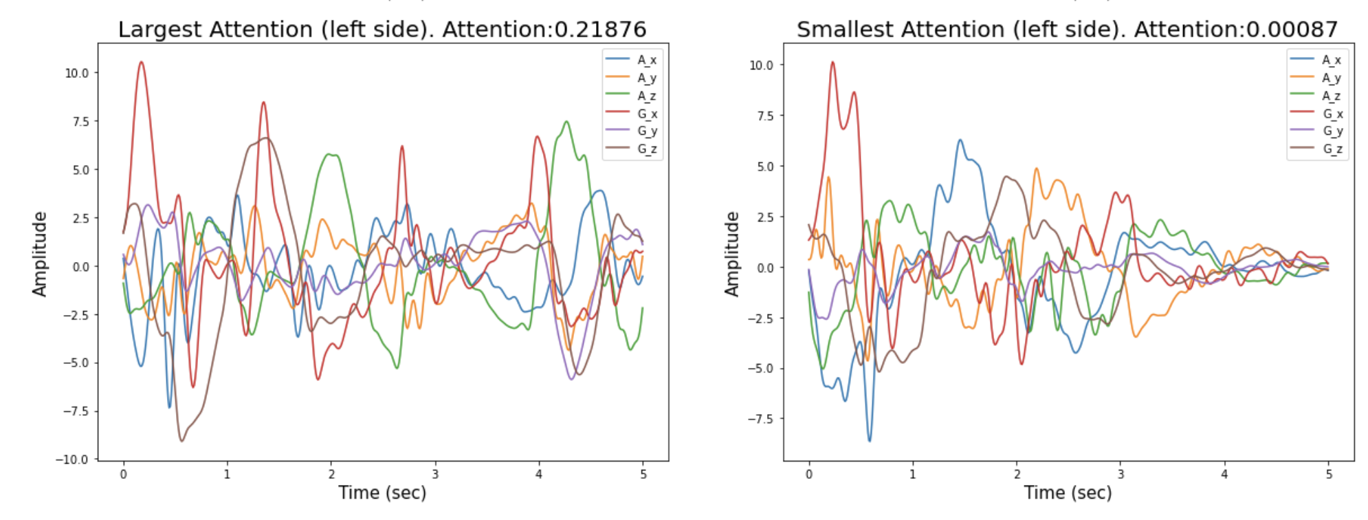
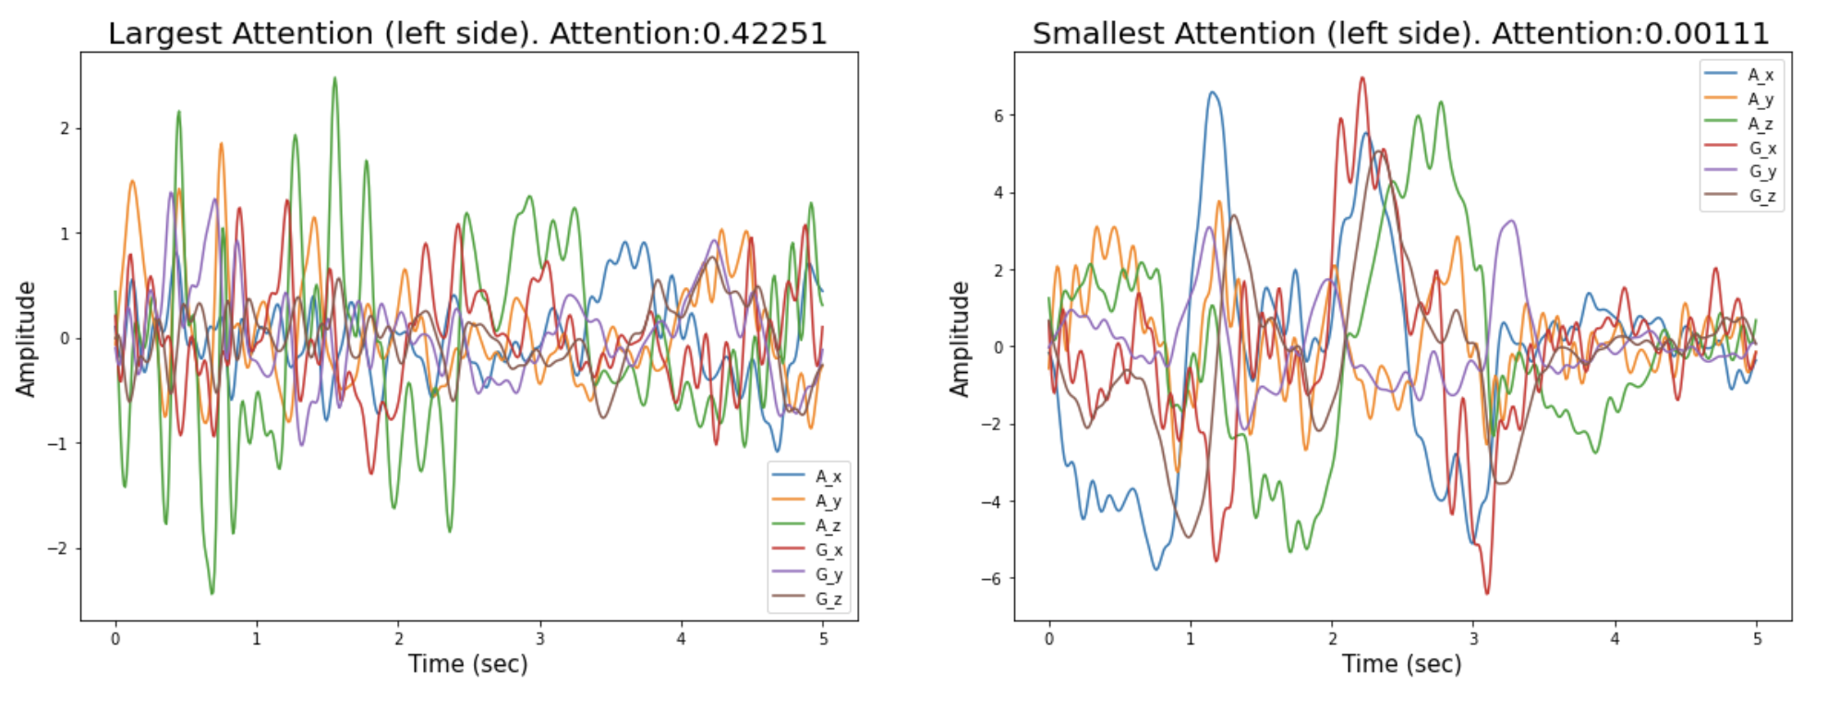
Results - Raw-model
True negative
False negative

Slide 17
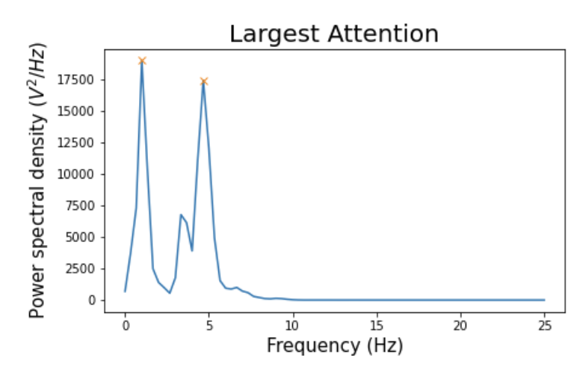
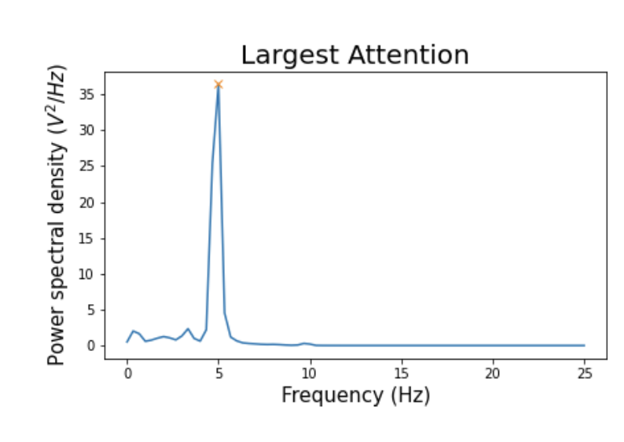
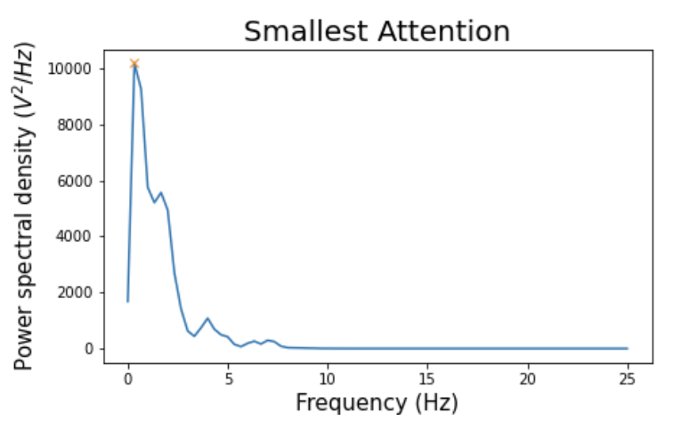
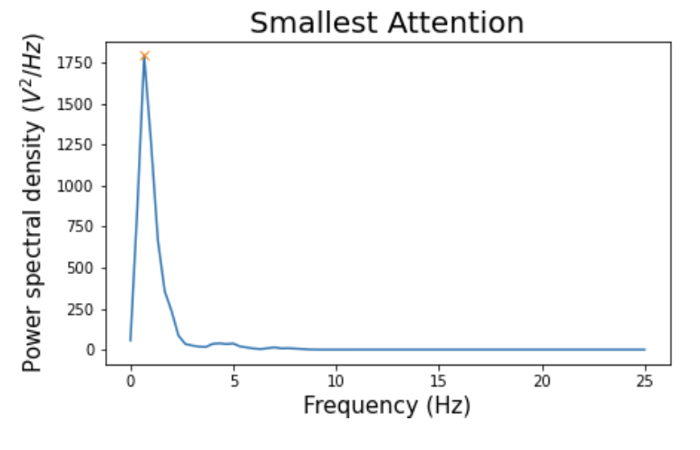
Results – Freq-Model
True positive
False positive
[1. and 4.67]
[5]
[0.34 ]
[0.667]

Slide 18
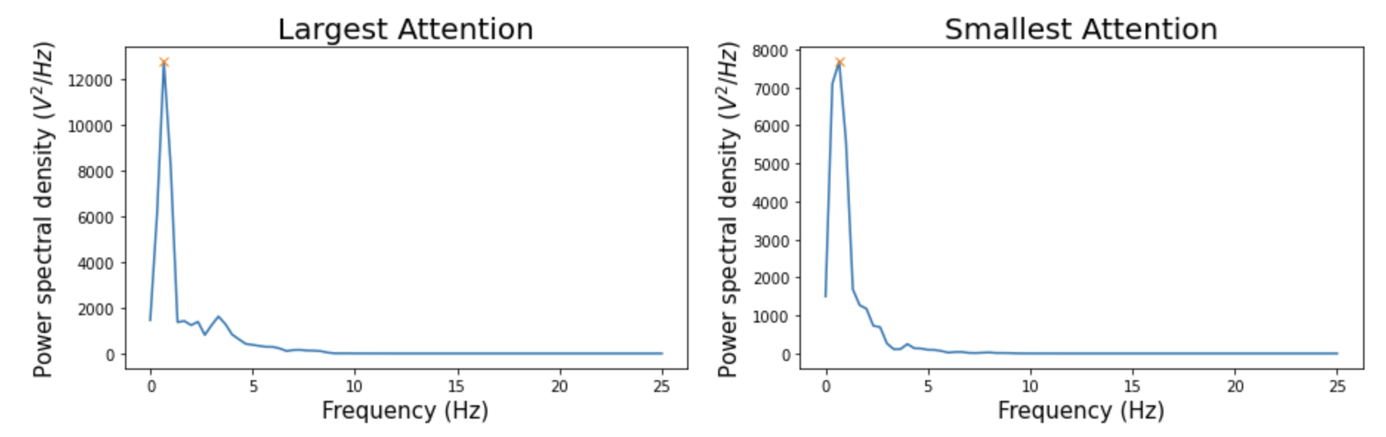
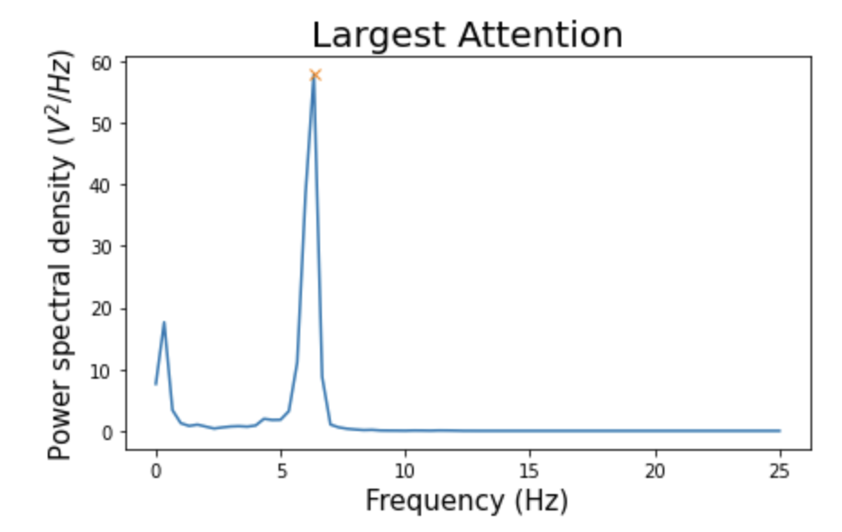
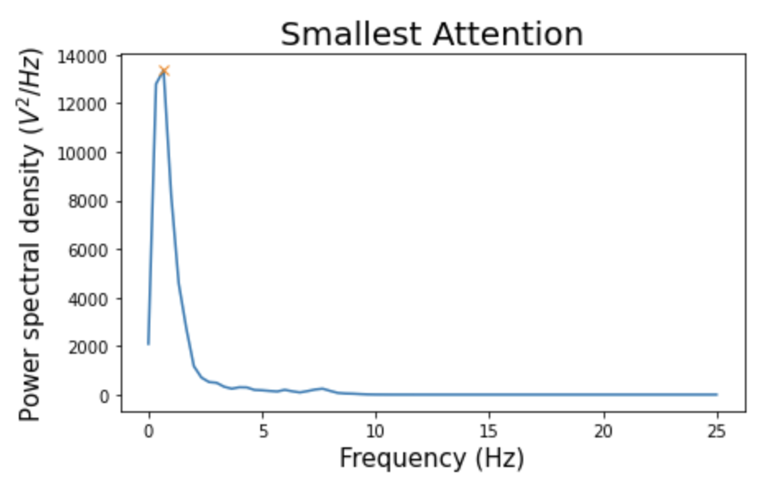
Results – Freq-Model
True negative
False negative
[0.6667]
[6.333]
[0.6667]
[0.6667]

Slide 19
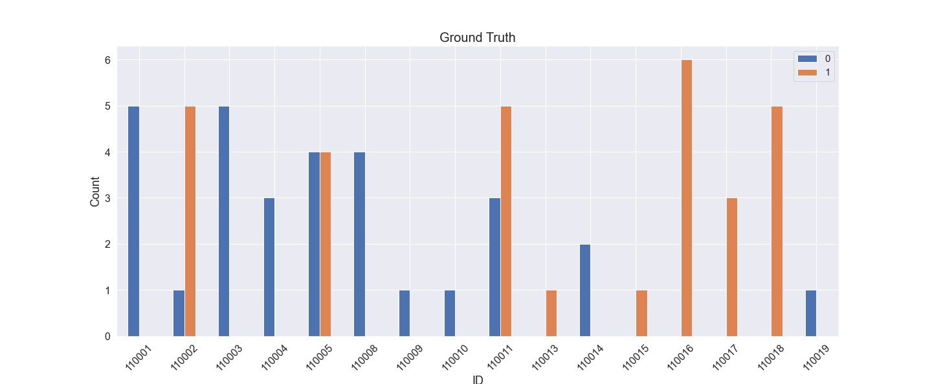
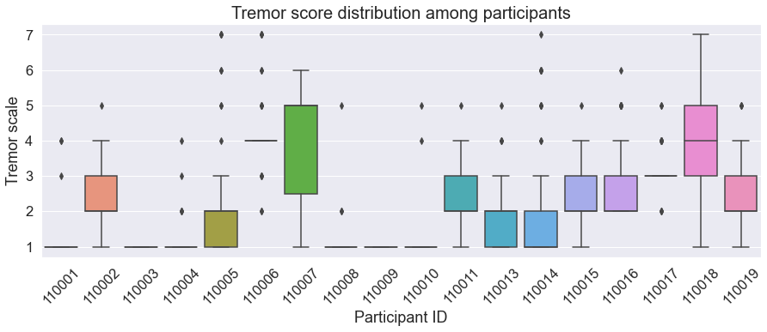
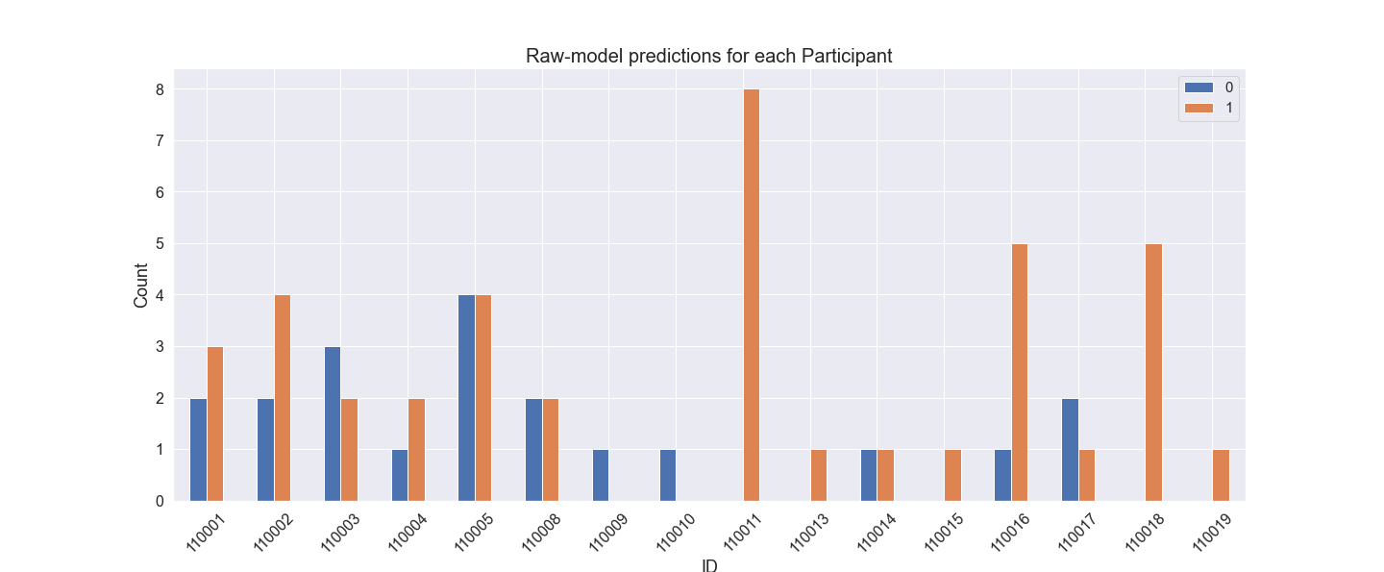
Results – Subject specific
Examples of the Raw-model’s performance according to subject ID.

Slide 20
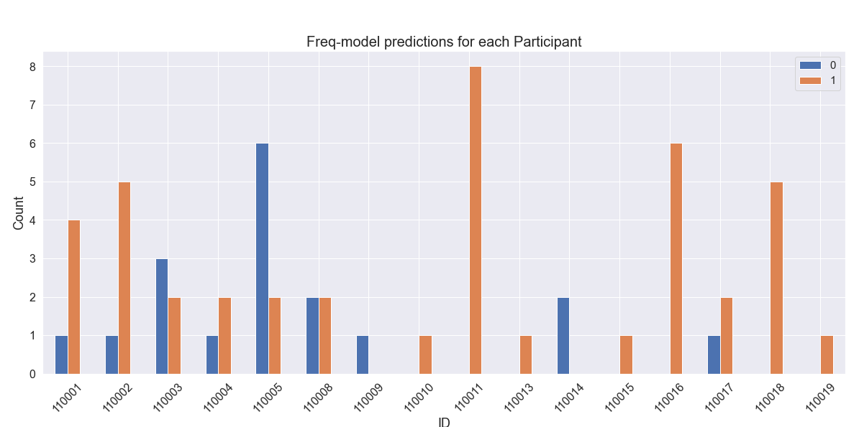
Results – Subject specific
Examples of the Freq-model’s performance according to subject ID.

Slide 21
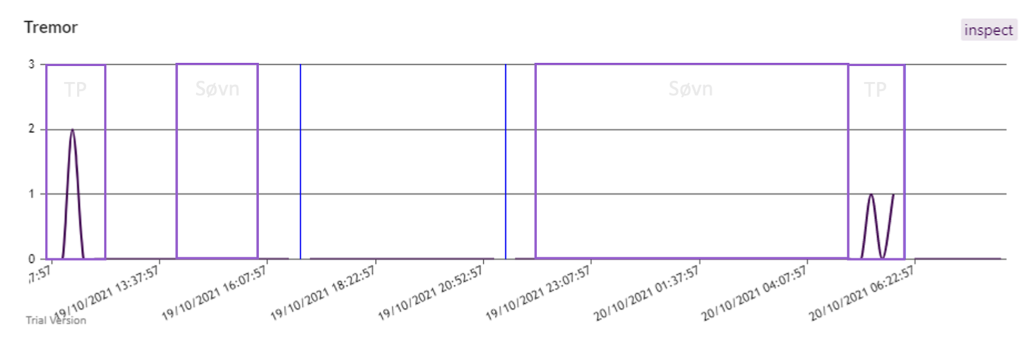
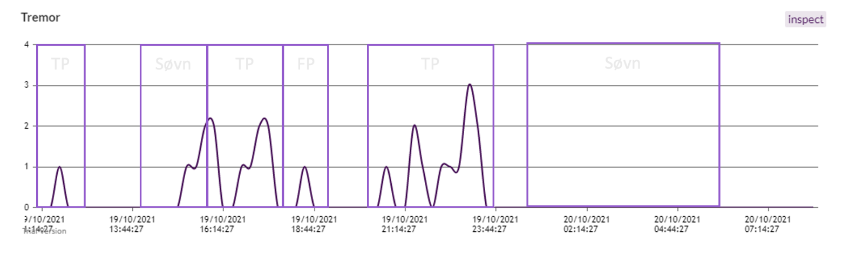
Results – Paragit Solutions’

Slide 22
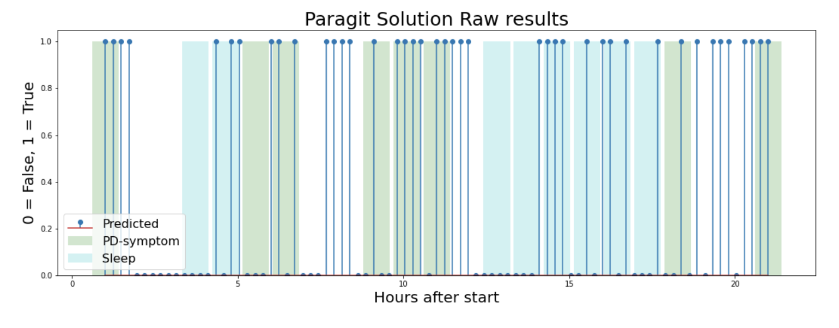
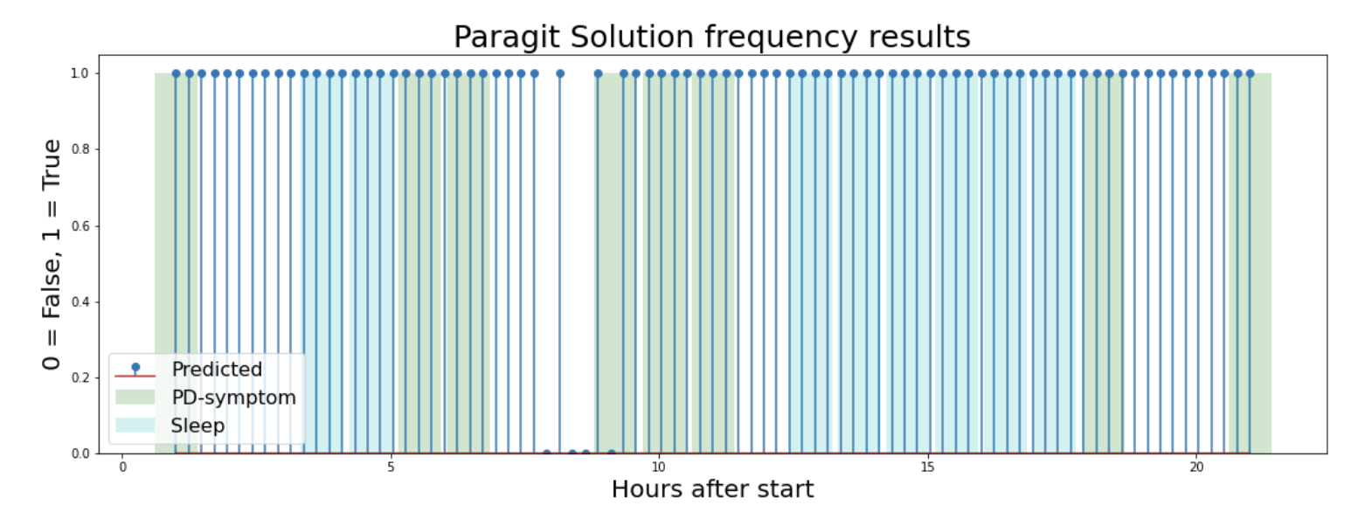
Results – Paragit Solutions’

Slide 23
Results - Compare

Slide 24
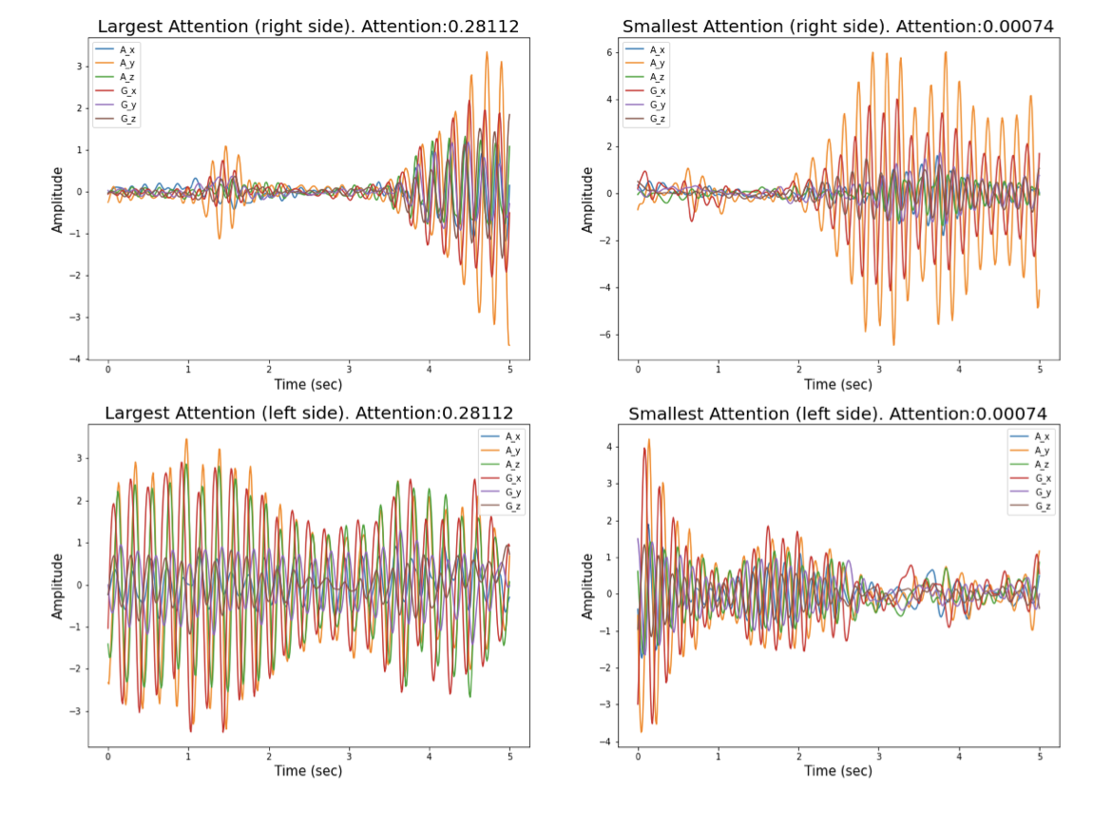
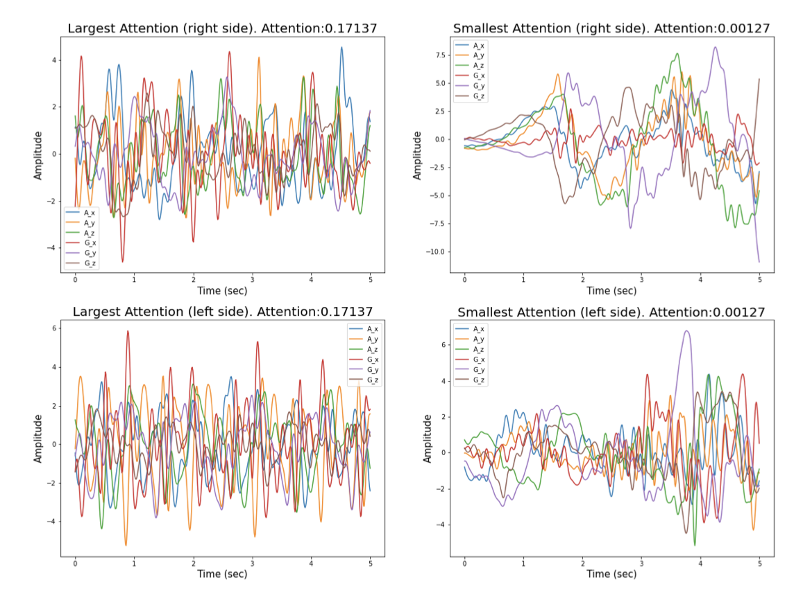
Results – Paragit Solutions’ (Raw-Model)
True positive
True negative

Slide 25
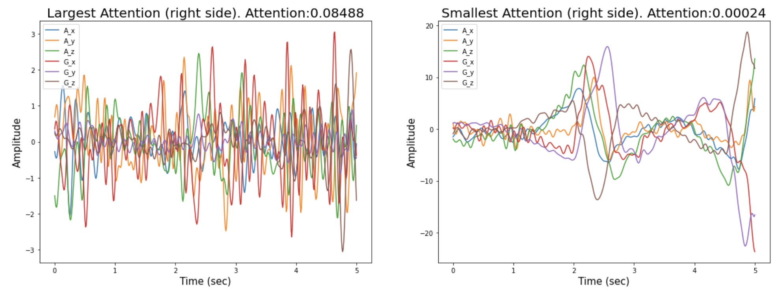
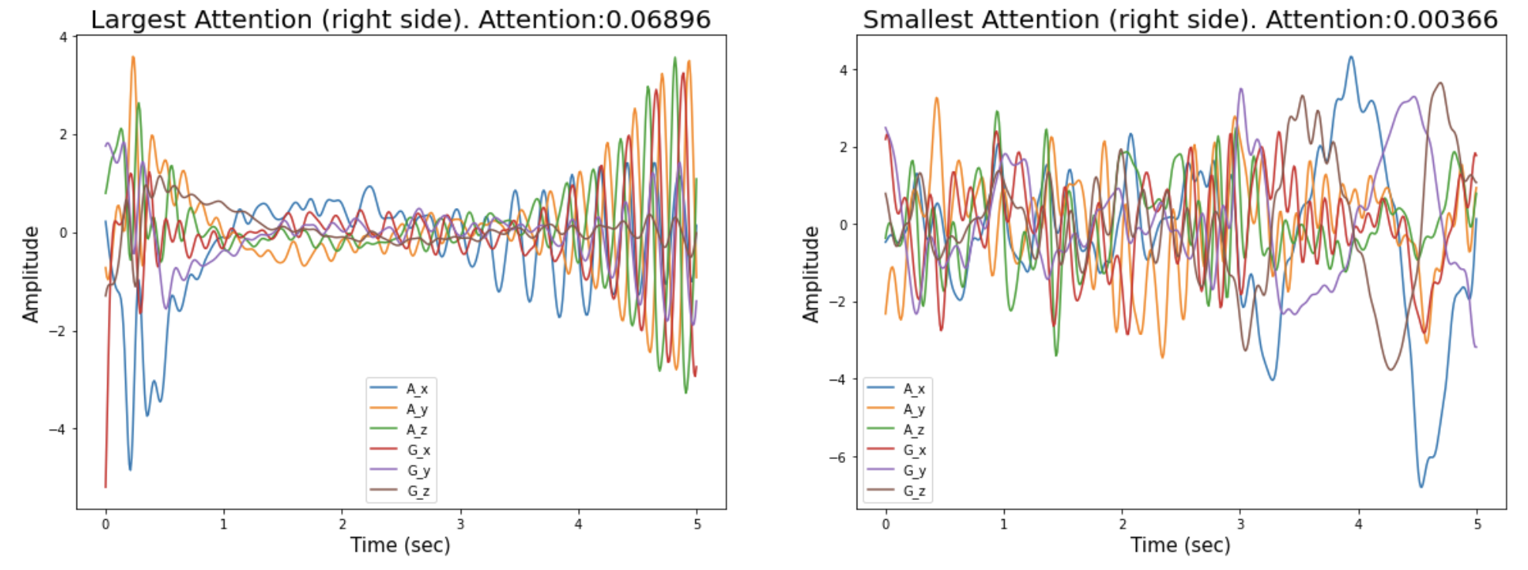
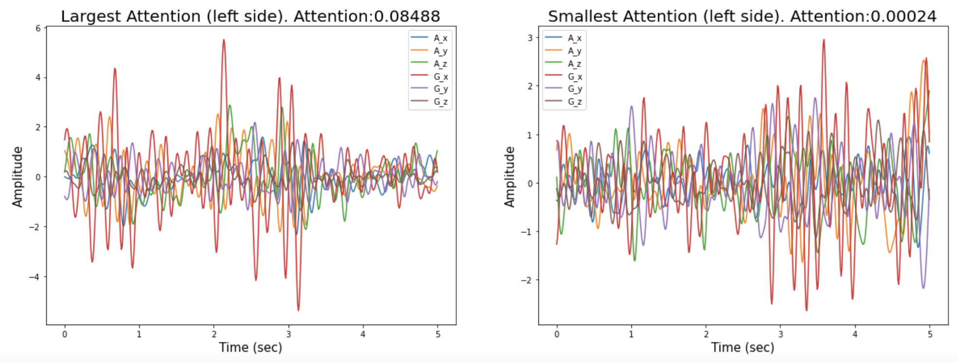
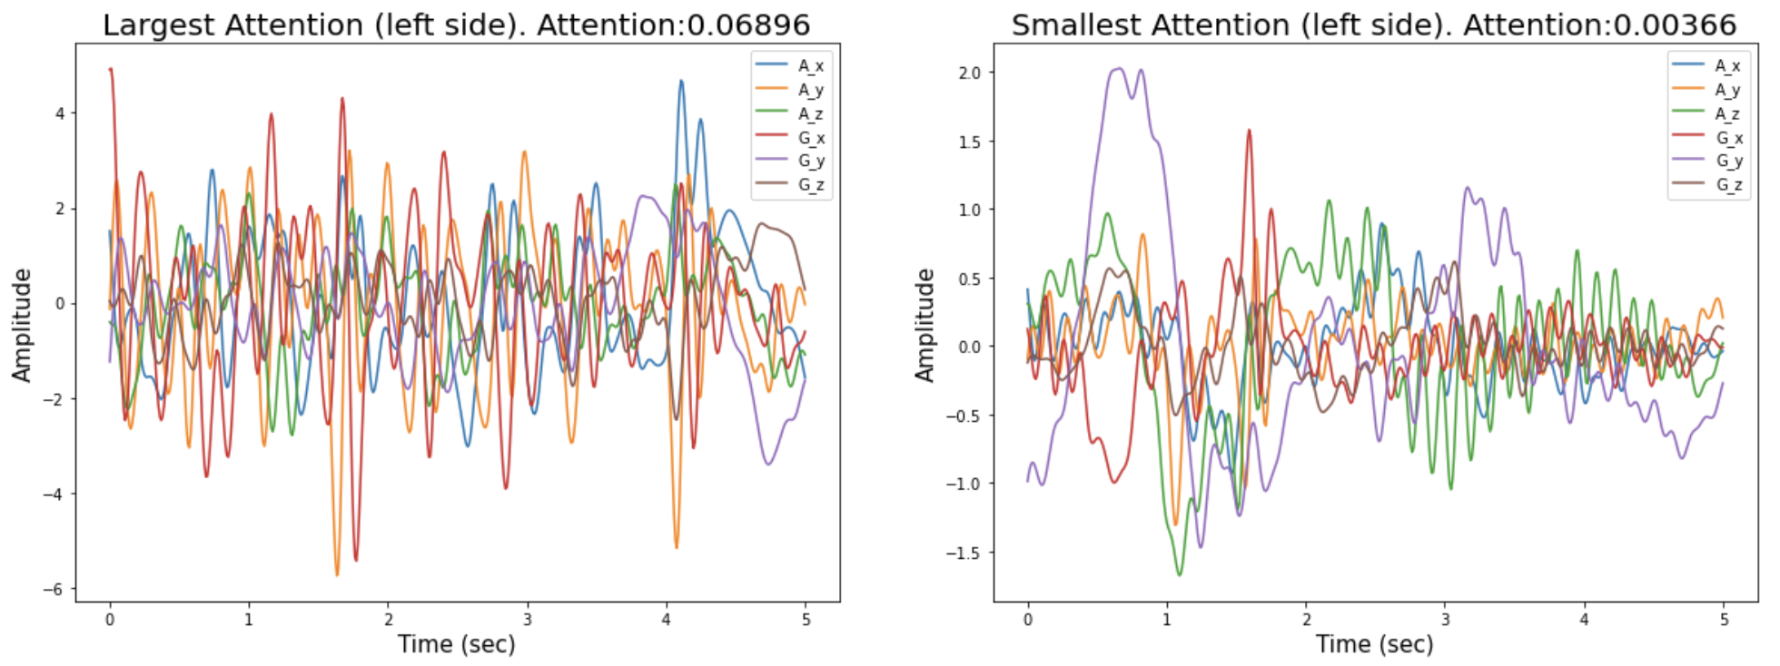
Results – Paragit Solutions’ (Raw-Model)
False positive
False negative

Slide 26
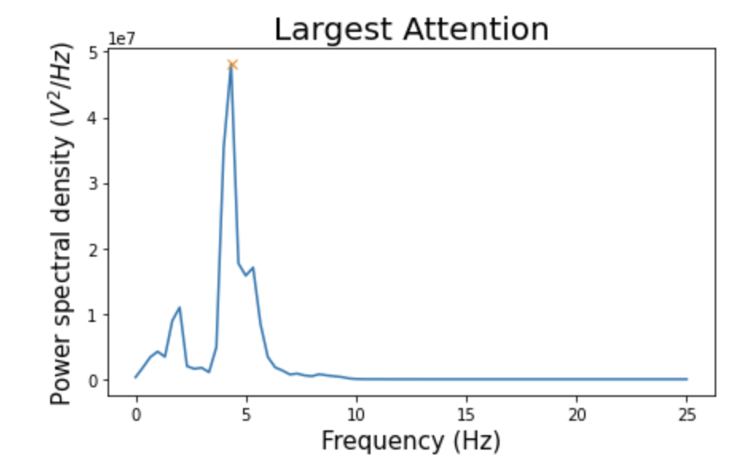
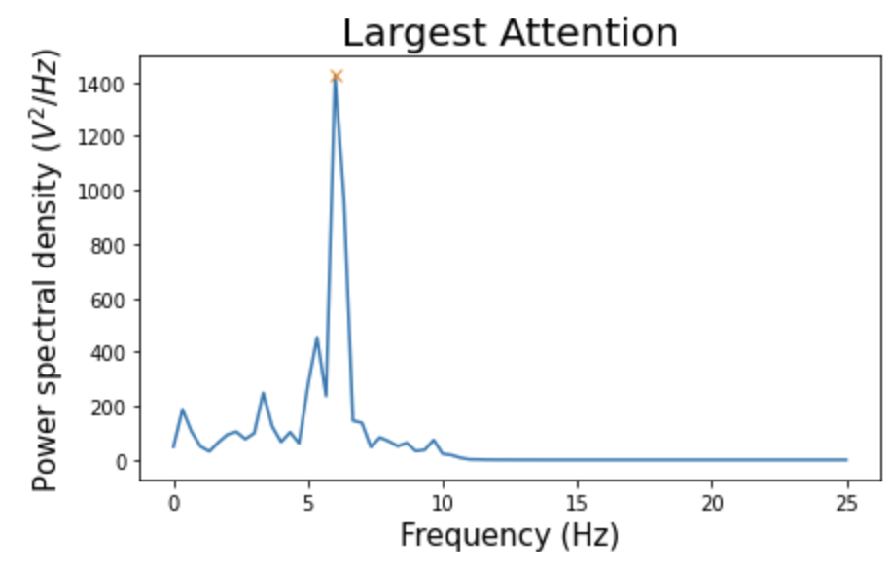
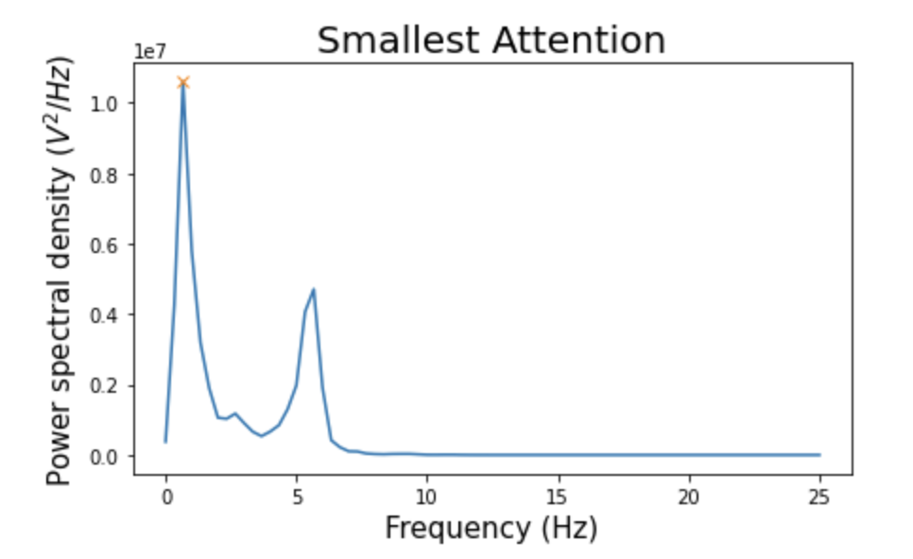
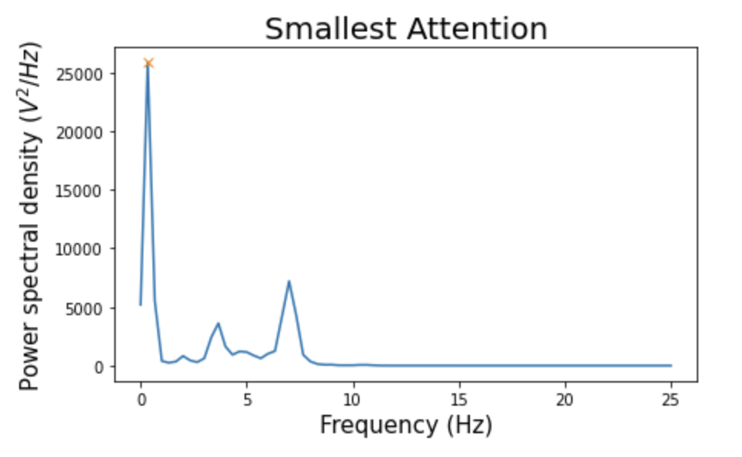
Results – Paragit Solutions’ (Freq-Model)
True positive
True negative
[6.]
[4.333]
[0.667]
[0.333]

Slide 27
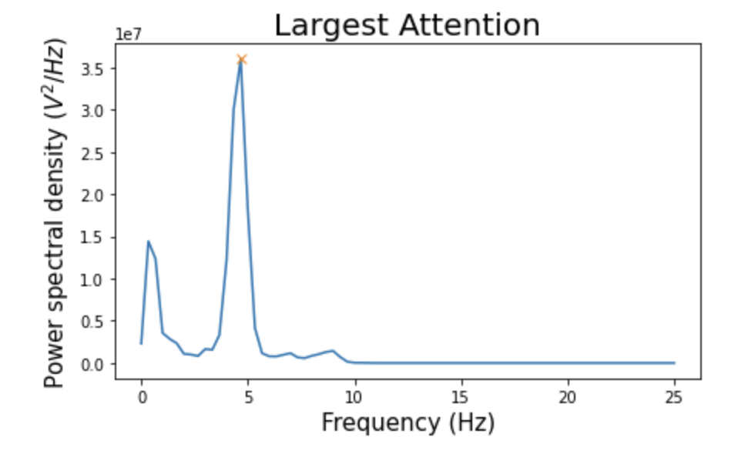
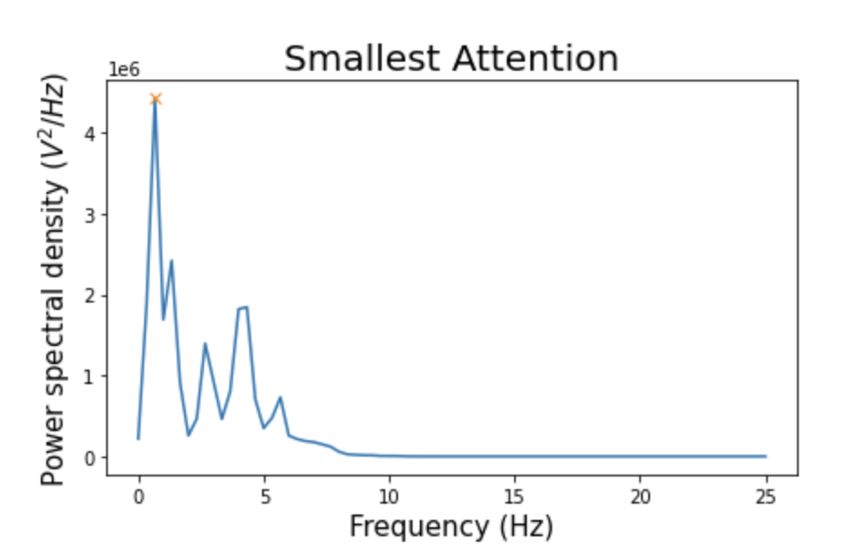
Results – Paragit Solutions’ (Freq-Model)
False positive
False negative
[4.667]
[0.667]

Slide 28
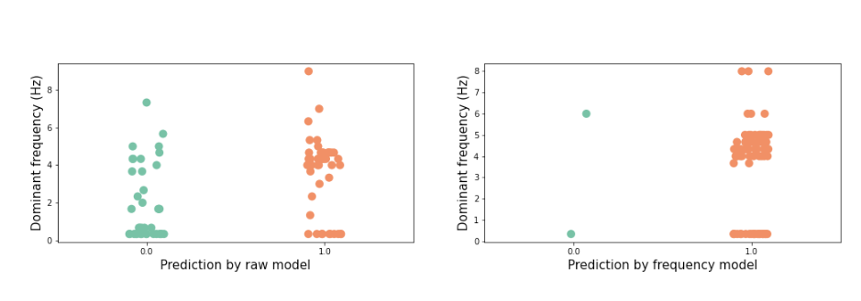
Results – Paragit Solutions’

Slide 29
Discussion #1 imbalance
Data imbalance could have caused the high number of predictions in the positive class
Preventative actions could be
Data augmentation or downsample the positive samples

Slide 30
Discussion # 2 Noise within the data
Tremor alike episodes
Wrist band not corretly tighten
Natually repetitative behavior (brushing teeth)
Many questions confuses the participants
One label accounts for both sides

Slide 31

Discussion #2 Overfitting

Slide 32

Discussion #3 Small data set
Validating the actual performance
Limited amount of test samples
Imbalanced data from participants
Habets et al. 60 samples from 16 people
The representativeness of the scales varies
Paragit Solutions 85 samples from one person

Slide 33
Future perspectives
The data collection protocal should be design such
The data can be validated (Trade-off method between clinical and wild data)
The description can not be misleading
Require large participant egagement
Designed to collect data with clear purpose (preferably one symptom at once – reduce the risk of mislabelling)
Increase label precision
Larger data set
Many participants
Different ranges of severity
Run a validation study with pre-trained model
Real time processing

Slide 34
Conclusion
Current algorithm is not able to used for clinical predictions for PD-tremor
F1-score of 0.657 with raw data input and 0.694 with frequency input.
Simliar results as UPDRS16 results from Papadopoulous et al. (0.615 +/- 0.011)
The raw model is performing the best on Paragit’s data
Currently it is not able to conclude which model is best for generalization

Slide 35
Limitations of the study
The data | The model
The design purpose of the data The amount of the data The diversity within the data The labelling Unable to do one-sided predictions / detection of symmetry of symptoms | Optimization protocals Many parameters The time limitation of training Overfitting

Slide 36


